Slide 1

People Strategy at SODEXO

Slide 2
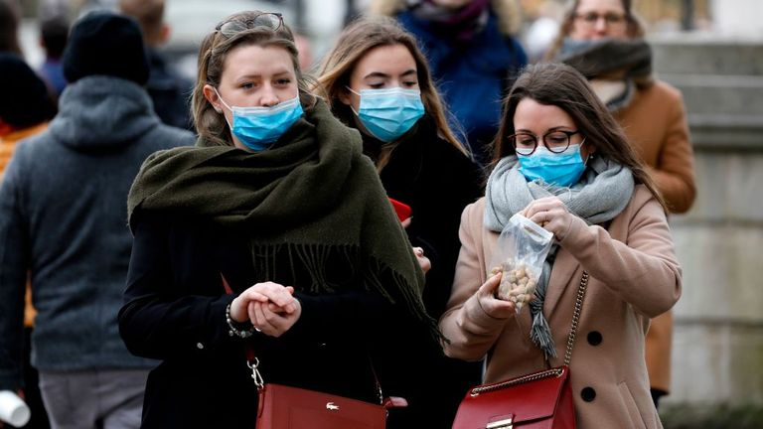
AdaptAbility
the art of winning in an age of uncertainty

Slide 3
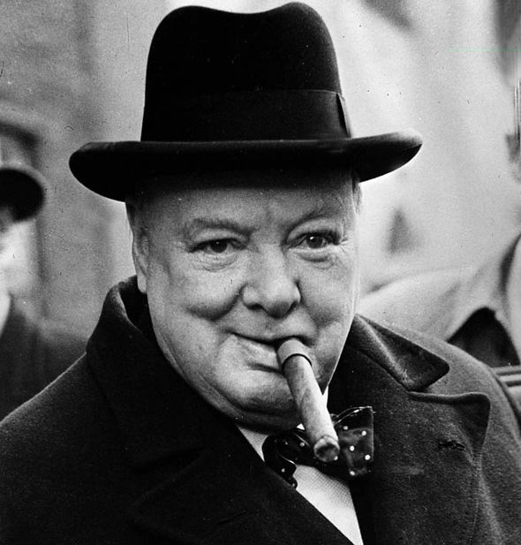
“Never let a good crisis to waste.”

Slide 4

This crisis is a portal to a new world.

Slide 5

New Ways of Working
PEOPLE
HEALTH & SAFETY
Continuous Communication
Engagement
Recognition

Slide 6

Practice Physical Distancing and
Preserve Social Connection.

Slide 7


Slide 8



Slide 9



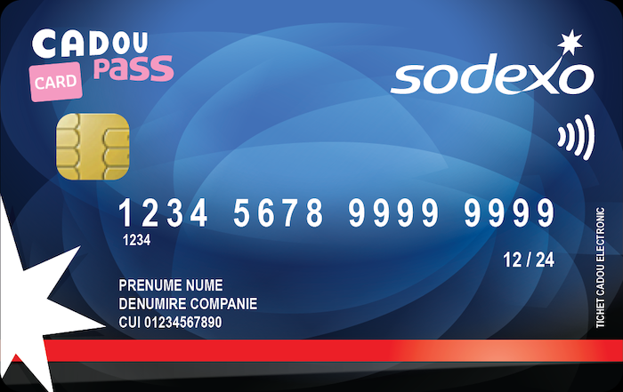

Slide 10





Slide 11



Slide 12

Adaptability
BUSINESS CONTINUITY
Digitalization
Technology
Corporate Social Responsibility

Slide 13



